Slide 1

Workshop: designing and developing
a tangible gesture lamp
Leonardo Angelini

Slide 2
Program
Presentation of participants
Individual choice of tangible gestures
Group formation
Brainstorming and design
Sensor choice
Learn by doing!
Discussion
User tests (tomorrow)
Winner group awarded (tomorrow)
Notes:
In the doing phase I will learn too

Slide 3
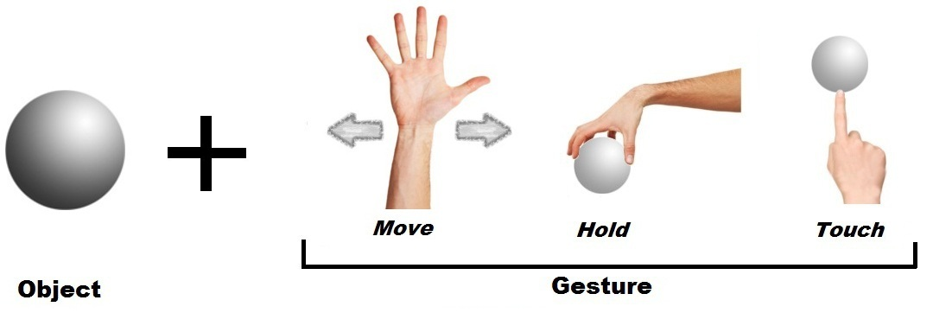

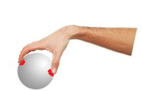
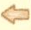
Gesture combinations
MOVE
TOUCH
HOLD
FGTIS| 28.08.2013 | Leonardo Angelini

Slide 4
Gesture Attributes
Are move, hold and touch sufficient to describe tangible gestures?
Use of “attributes”:
amount (three-fingers touch gesture)
pressure (force applied while holding-> squeeze)
time (object touched three seconds)
direction
speed…
FGTIS| 28.08.2013 | Leonardo Angelini

Slide 5
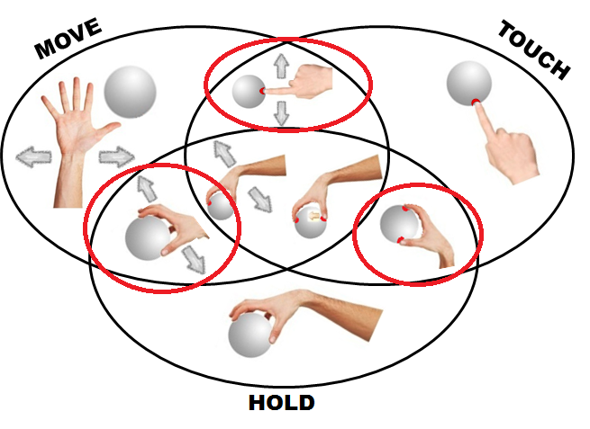
Choice of a two-fold gesture class
Notes:
Think to a desktop lamp and try to imagine which gestures the user would like to use to interact with this lamp. During this choice you should think only to the form of the lamp and of the gestures. Don’t think to the meaning and the effects that gestures will have.
I will explain later why only two fold gestures.

Slide 6
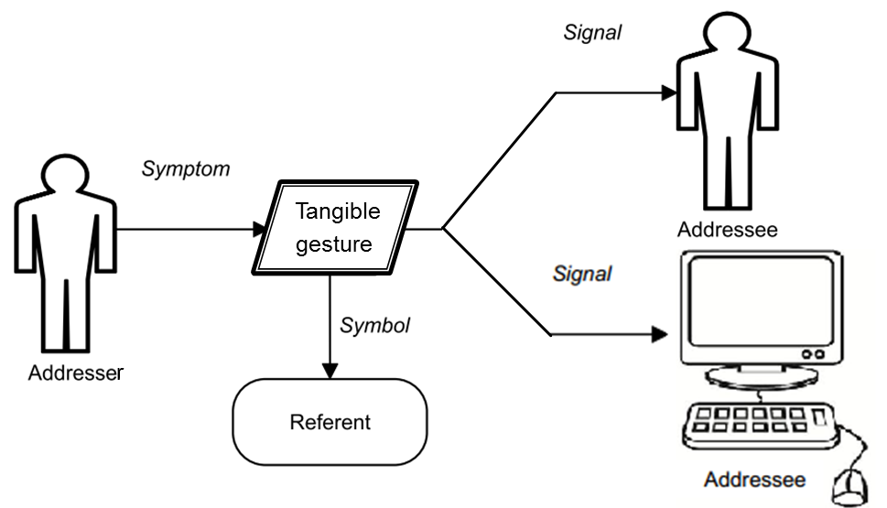
TGIF – Communication model
FGTIS| 28.08.2013 | Leonardo Angelini
Notes:
Addresser is not only computer but also other participants to the interaction (collaborative scenarios)

Slide 7
Choice of a two-fold gesture class
Notes:
Semantic choice

Slide 8
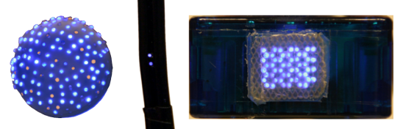
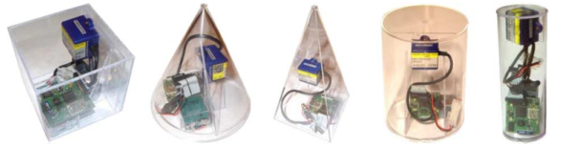
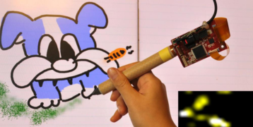
Recognition approach: Embedded and embodied
Embodied perspective of gestures:
the object is being touched, held, moved
FlyEye, 2010
Ferscha et al., 2011
MTpen, 2011
Notes:
Show sensors.

Slide 9
Choice of a two-fold gesture class
Notes:
Technological choice

Slide 10
Challenge
3 groups – each group has a main component (move, hold, touch) not available
Design and build a tangible gesture lamp that will be evaluated by users
Usability test (SUS)
Winner -> Valuable Prize
Notes:
Comparing how different component could influence the design.
Discussion if SUS is appropriate.

Slide 11
SUS – Rate 1 to 5
I think that I would like to use this system frequently.
I found the system unnecessarily complex.
I thought the system was easy to use.
I think that I would need assistance to be able to use this system.
I found the various functions in this system were well integrated.
I thought there was too much inconsistency in this system.
I would imagine that most people would learn to use this system very quickly.
I found this system very cumbersome/awkward to use.
I felt very confident using this system.
I needed to learn a lot of things before I could get going with this system.
Notes:
System Usability Scale. Is a standardized usability questionnaire.
Usability affected by performance. Wizard of Oz allowed.
Usability affected by aestethics!

Slide 12
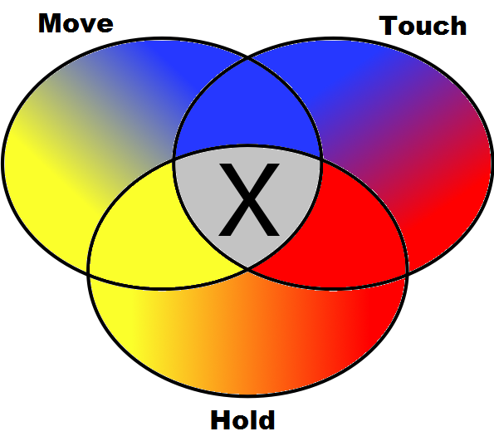
Available gestures
Notes:
Each group do not have access to one of

Slide 13
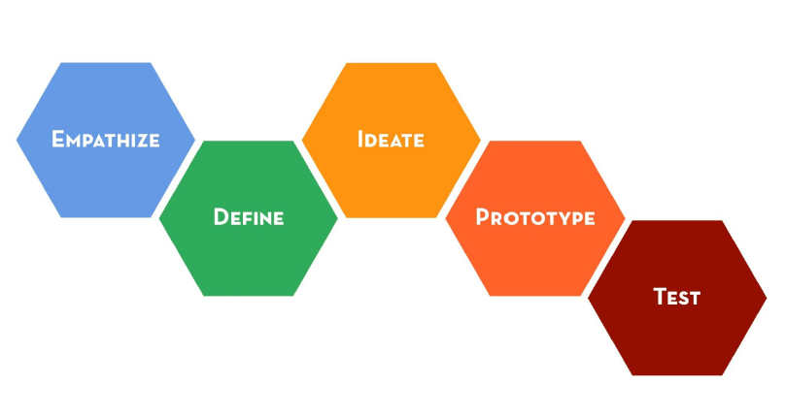
Design thinking principles
Notes:
Try to understand the user needs by observation
Formalize these needs

Slide 14
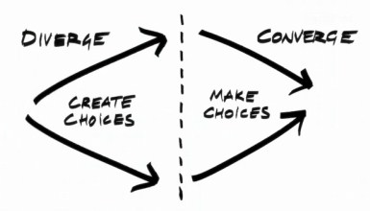
Design thinking principles
Notes:
Brainstorm, collect ideas, generate new ones, use post it

Slide 15

TGIF – Designer role
The referent could not be the same.
=> The designer should inform the participants to the communication about the common referent.
FGTIS| 28.08.2013 | Leonardo Angelini
Notes:
Addresser is not only computer but also other participants to the interaction (collaborative scenarios)

Slide 16
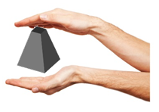
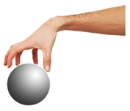
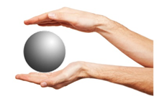
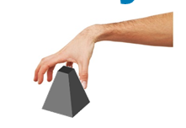
Semantic 2D map
Gesture coherence
Referent
[*]Koleva et al .2003
Object coherence[*]

